Slide 1
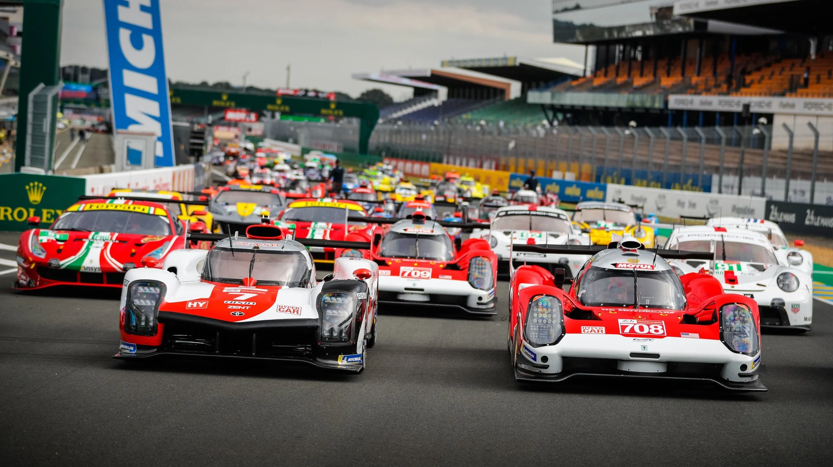
Multi-Class Classification for WEC Driver Ratings
Final Project for Ironhack Data Analytics
by Chris Costa

Slide 2
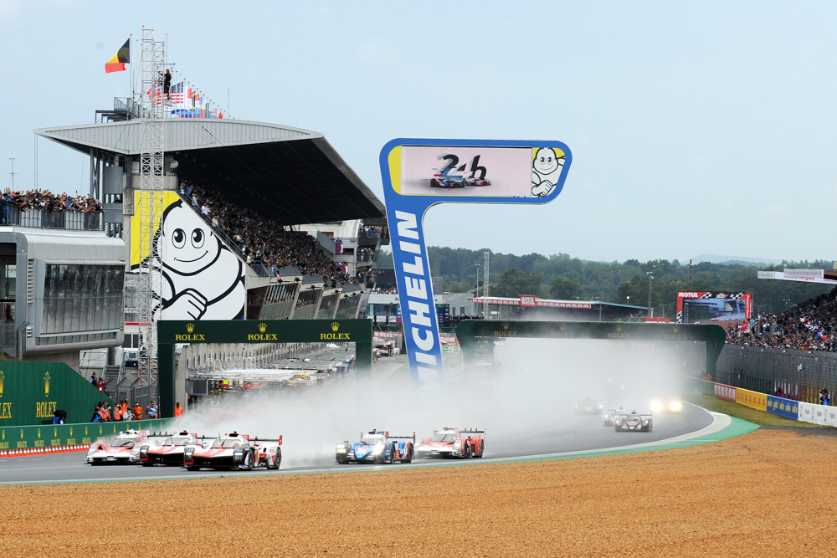
Project Goals
Apply several machine learning methods to predict the grouping of racing drivers into the categories of the FIA ratings system.
Assess the effectiveness of the FIA rating system at grouping professional and amateur drivers based on their on-track performance.
Develop a re-useable model that can be applied to future series data and continue to group drivers as talent levels improve and career experience progresses.

Slide 3

The FIA World Endurance Championship
The World Endurance Championship has run since 2012 and is focused around the famous Le Mans 24 Hour race
6-8 Races per season running from 4 hours up to the full 24 hours
4 Car classes competing amongst themselves while sharing the same track.
LMP1 and GTE-Pro for automotive OEM’s and professional drivers
LMP2 and GTE-Am for lower performance versions of cars and mixed pro-am driver lineups.
Long races mean multiple drivers sharing a car during the race.

Slide 4
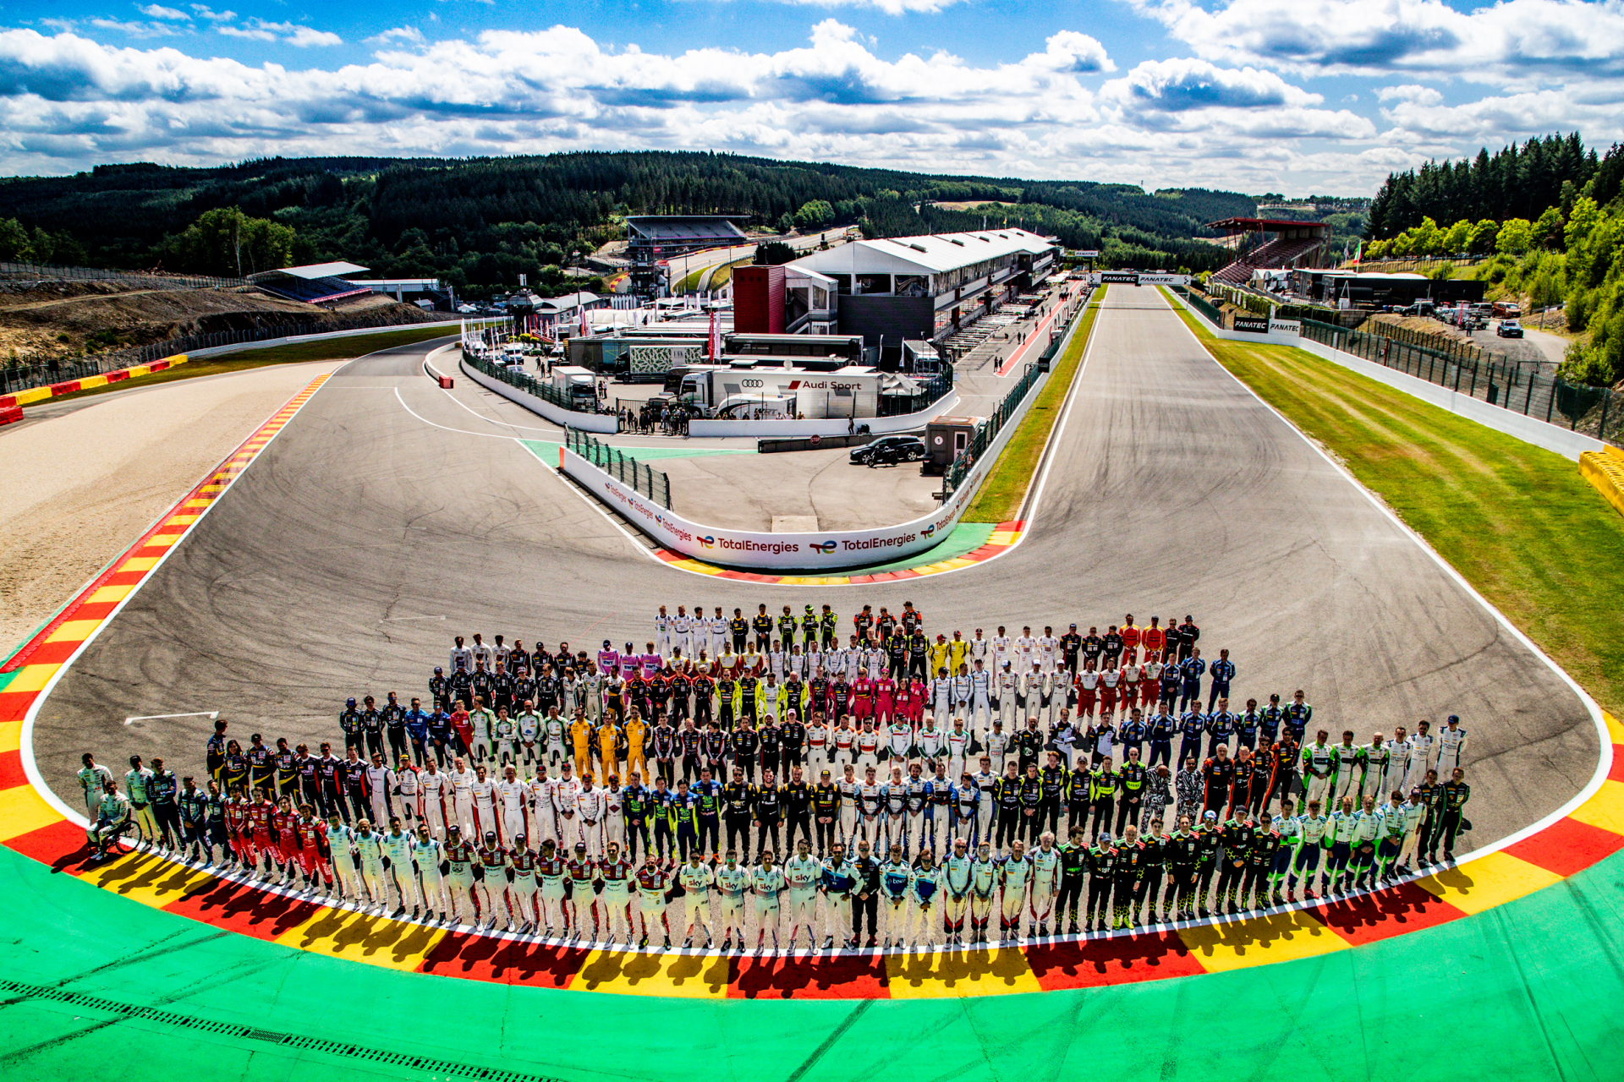


FIA Precious Metals Rating System
Ratings system devised in 2016 to ensure balanced driver talent in pro-am categories.
Drivers are rated into Bronze, Silver, Gold, and Platinum based on career experience and achievements.
Platinum rating for the most experienced and highly decorated professional drivers.
Gold ratings are for established pros who have not yet achieved the criteria for Platinum ratings as well the most accomplished amateurs.

Slide 5

FIA Precious Metals Rating System
The silver rating is primarily for the most talented/accomplished amateurs and for young and aspiring pros in the early stage of their career.
The Bronze rating is the lowest level of the FIA rating system and is applied to lowest levels of experienced drivers allowed to compete in the series.
Drivers older than 50 and 55 years of age receive an automatic downgrade in rating.

Slide 6
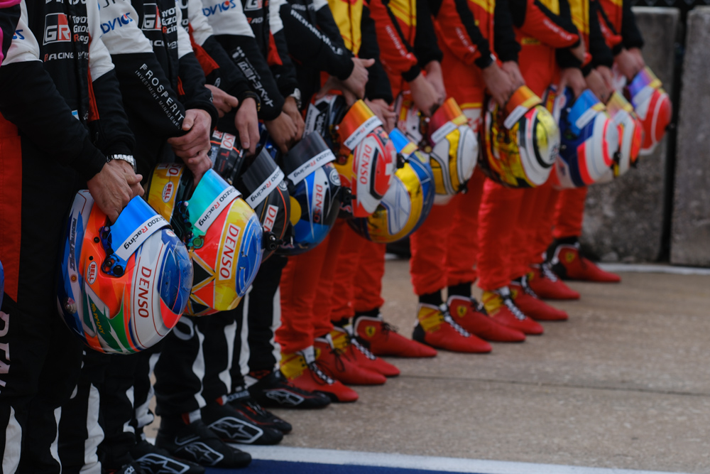
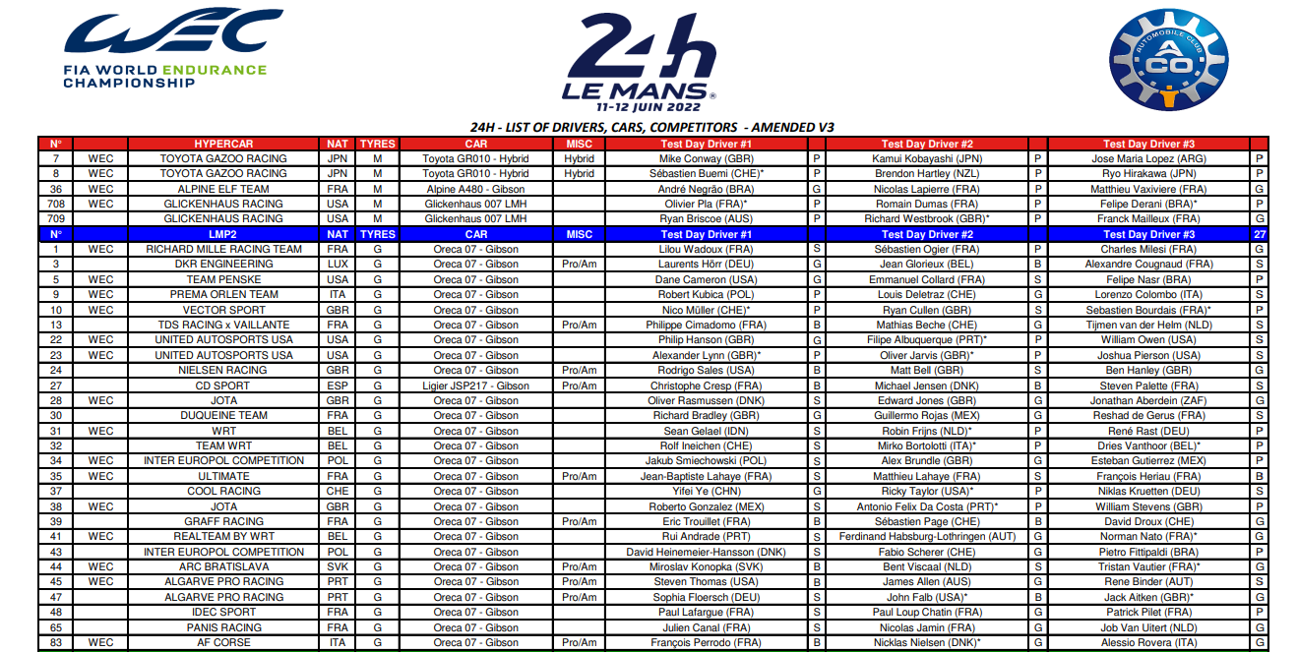
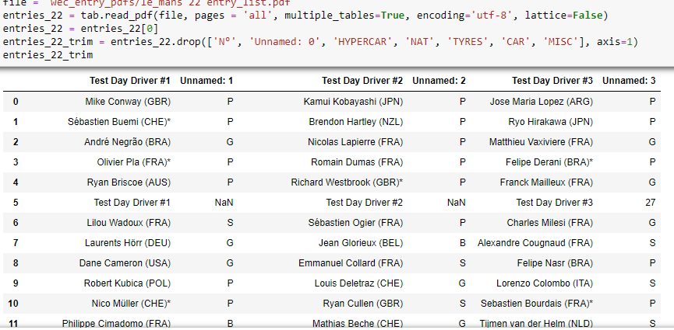
Scraping PDF Files
Driver Ratings data had to be scraped from event entry lists in PDF format.
Tabula-py library is a python wrapper for the Tabula Java package.
Lattice=True argument allows the scraper to find tables in the PDF and convert them to a DataFrame

Slide 7

Feature Engineering
Season column was replaced with a year column.
The 2018/19 and 2019/20 “Super Seasons” were replaced by checking the round number against known season schedules to place those records with the appropriate year.
A clean and consistent year column was necessary for two reasons:
Ease of merging the scraped driver ratings data which are updated yearly
Interpretation of laptime data as car performance changes from year to year.

Slide 8

Adding The Driver Ratings
The names in both the scraped data and main data needed to be cleaned up
Unidecode was used to remove ~ , ü, and ó type symbols
Names were all swithed to lower case and trimmed of trailing or leding whtespaces
The two dataframes were merged on the year and driver name columns
12% of driver names remained un matched but this was an acceptable percentage to drop.

Slide 9
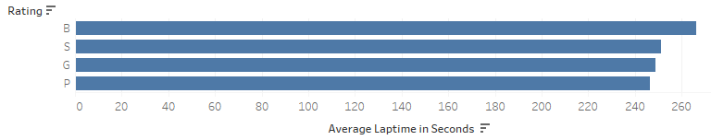
Feature Engineering
A new column was derived to show a rolling average of the last 5 laps for each driver.
This function works only on laps done by a driver in the same stint and the same race to avoid incorrect averages.
Average pace is considered a more important trait than a single lap pace in endurance racing.
Consistency throughout a stint is the hallmark of a truly skilled driver.
The lower average laptime over the course of a season or race corresponds to a higher driver rating.

Slide 10
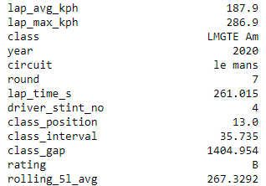
Removing Outliers
Outliers in a dataset can skew the results of a model
Artificially long laptimes caused by crashes and breakdowns can make a drivers performance appear poorer than reality.
Outliers are checked by calculating the interquartile range of the data (the between the 25% and 75% values) and then setting an upper limit.
Values above the upper limit are removed from the dataset
The remaining maximum laptime is checked to determine the best setting for the upper limit value.
The 261 second lap shown here is a reasonable upper limit
when considering the circuit, driver rating, and car type.

Slide 11
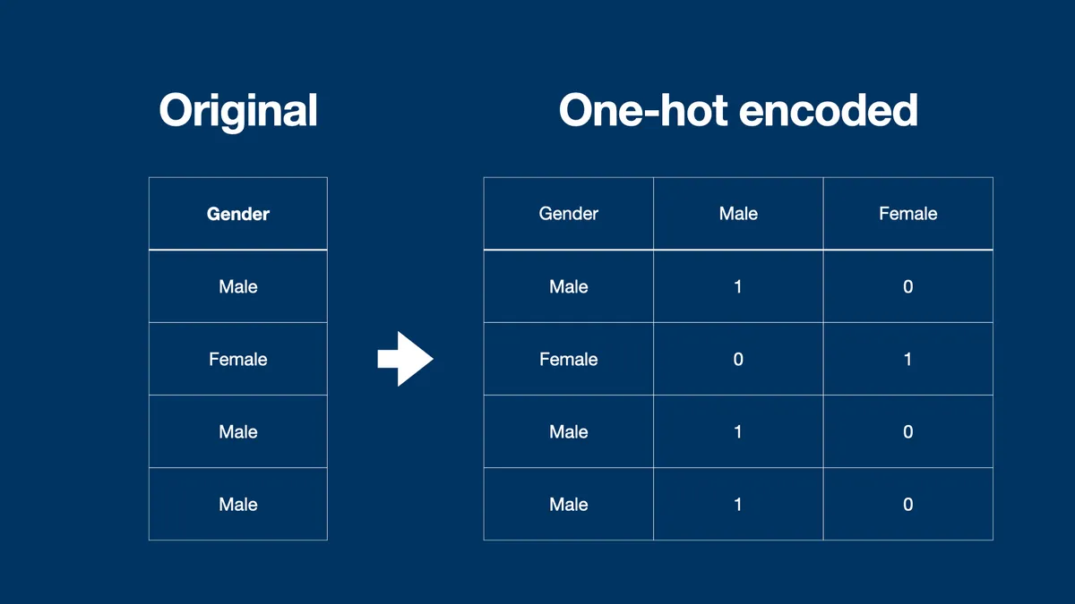
Transforming and Encoding
Text based ‘object’ type columns are one hot encoded
This replaces the columns with new dummy columns for each unique value.
Continuous numerical columns are scaled
Numerical values must use the same scale to prevent bias towards higher value columns.
For the best model accuracy we will test multiple scaling methods
MinMaxScaler
StandardScaler
MaxAbsScaler

Slide 12
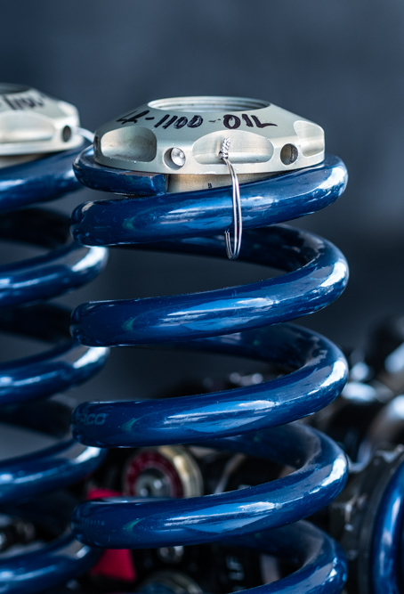
Fitting and Evaluating Models
Random Forest Classifier
Ensemble method fits multiple sub models and takes the most popular result as its predicted value.
Initial test returns 89% accurate results.
K Nearest Neighbors Classifier
Groups values based on nearest K number of values.
Initial test returns 83% accuracy

Slide 13
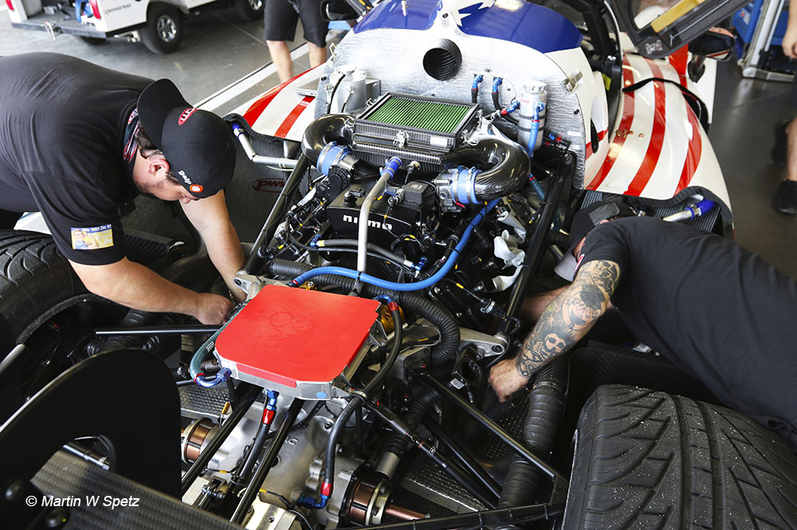
Hyperparameter Tuning
Machine learning models have user configured hyperparameters to control model behavior
Tuning operations will make automatic runs through a selected set of parameter values.
For each run of the model the accuracy will be evaluated.
The parameter set resulting in the highest accuracy score will be output and stored for later use.
Tuning operations can take along time to run. The more parameter options mean more runs of the model.

Slide 14

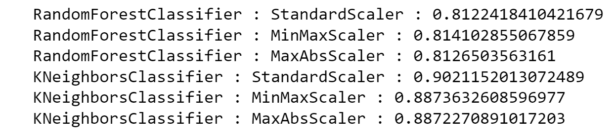
Final Model Testing
Testing both models against all three scaled data versions
Models will be run with the pre-determined best hyperparameters
Each model will run three times; once for each of the scaled data versions
At the end of this model testing function we have scores for each model/scaler combination
The KNeighbors model with StandardScalar data returned the maximum score and will be stored for use on future data.

Slide 15
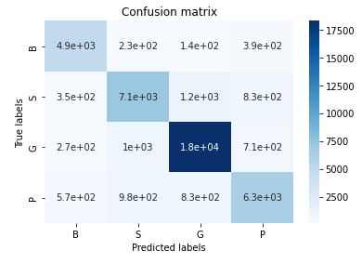
Heat Map
Heatmap representation of a confusion matrix
Shows the number of true predictions along the diagonal line
The Gold rating was the most accurately predicted class.

Slide 16

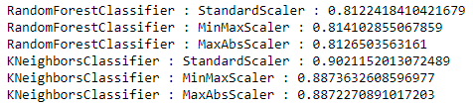
Conclusions
High model accuracy to the training data shows that the FIA rating system is overall effective at its task.
While the StandardScaler came out to show the best accuracy with the KNN model the scaler option does not show to have a large effect on model outcomes.

Slide 17
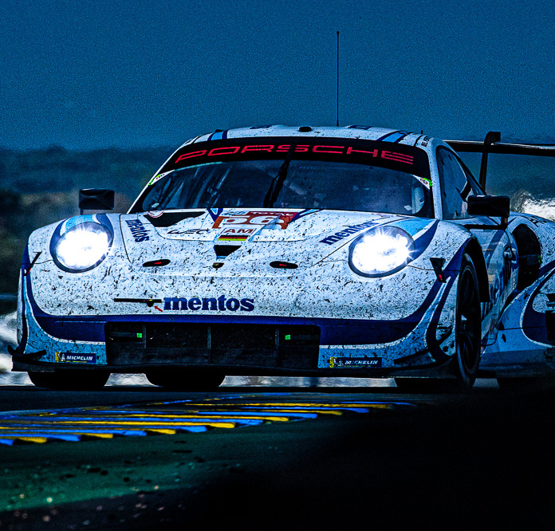
Storing and Reusing The Model
The final model is exported and stored as a pickle file using the joblib library.
The model can be reused and applied to new data from more recent WEC races.
The new data would require more extensive work to replicate the preparation done to the Kaggle data set.
As a future extension to the project work and learning done here I will continue to explore the future WEC data to track the accuracy of these models and make further insights.

Slide 18
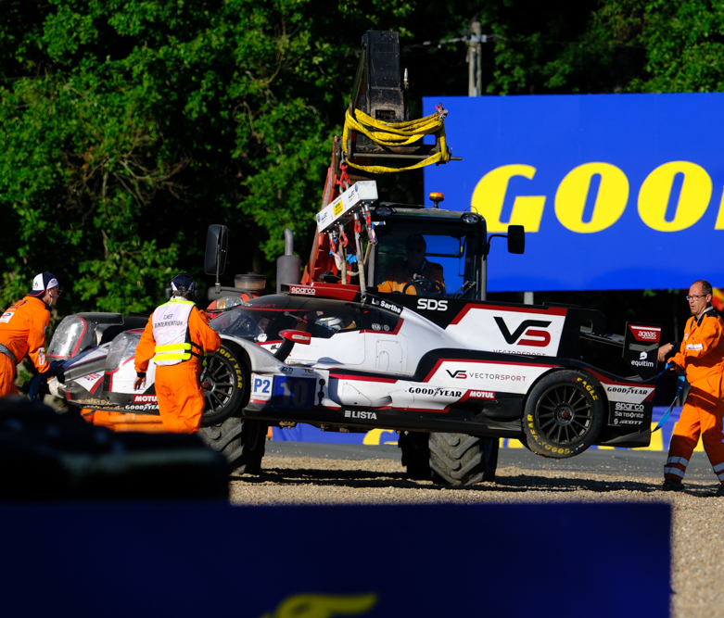

Headaches, Holdups, and Roadblocks
Size of the data making several making otherwise simple functions take extra time to run and iterate.
New situations required new solutions

Slide 19

Thank you for your time
Ironhack Data Analytics Final Project
By Chris Costa

